Slide 1
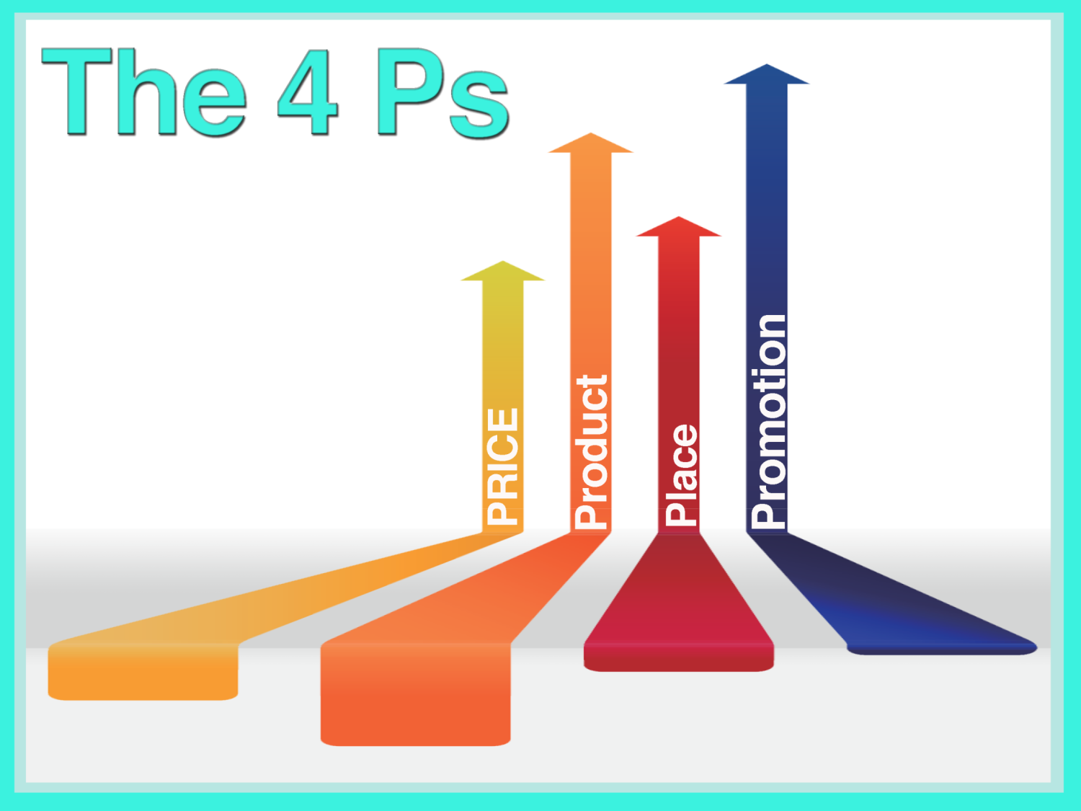

Slide 3
The Marketing Mix
Defines the key management decisions needed to be successful in marketing
Includes four basic marketing strategies, known as the “4 Ps”
price
product
place
promotion

Slide 4
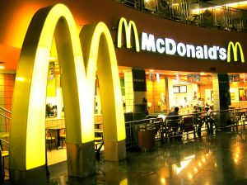
The Marketing Mix
Must be customer driven
Should relate directly to a company’s target market
Includes four interrelated concepts and tactics
Refers to the variables a company can control

Slide 5
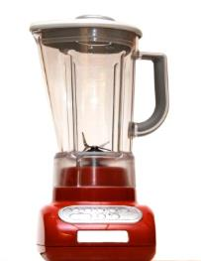
“The Mix”
Represents the idea that four significant marketing concepts (the 4 Ps) must be strategically coordinated and work together in order to create cohesive business decisions
Business Buzz:
The “marketing mix” concept was first developed by Neil H. Borden in 1964 after he published an article describing the role of marketing as a “mixer of ingredients”

Slide 6
The 4 Ps
Price
Place
Product
Promotion
The Marketing Mix

Slide 7
Marketing Mix Decisions
Price | Product | Place | Promotion
list price | appearance | channel members | advertising
discounts | quality | market coverage | personal selling
payment terms | packaging | sales locations | public relations
financing | branding | transportation | message
promotional pricing | services | inventory control | media budgets
Business Buzz:
The marketing mix consists of a number of essential functions. Which of the 4 Ps do you think is most important?

Slide 9
Basic Pricing Decisions
Determining a suggested retail price
Implementing a pricing strategy
Creating volume discounts
Generating seasonal pricing
Producing bundle prices

Slide 10
Price: Customer Application
Customers understand value
Price is a psychological variable
it alters a buyer’s motivation
price can influence the perception of status or luxury
price can stimulate or decrease demand
Pricing strategies which do not relate to customer habits will be unsuccessful

Slide 12
Product
Selecting which products to buy and sell
Researching and creating product designs
Naming and packaging products
Updating, improving or eliminating products from a product line

Slide 13
Product
Developing new uses or new target markets for a product
Examining the product life cycle
Adding features to an old product

Slide 14
Basic Product Decisions
Brand or product name
Styling
Quality
Safety
Packaging
Repairs and support
Accessories and services

Slide 15
Product: Customer Application
Customers buy benefits – not products
Products must satisfy a customer want or need
Consumers are often heavily influenced by brand name or packaging
Extended services or warranties can create customer loyalty
New and improved products often have a high success rate

Slide 17
Place
Is also described as “distribution”
Refers to introduction of the product to consumers and determining appropriate transportation or delivery methods
using semi-trucks or airfreight carriers
utilizing intermediaries or wholesalers in the distribution process
Includes whether or not products should be sold online or internationally

Slide 18
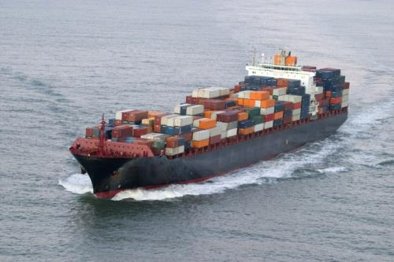
Place (Distribution)
Understanding where customers shop
Determining how and when a product will be distributed
Making decisions about product expansion or international sales

Slide 19
Place (Distribution)
Determining which retail outlets will carry specific products
Selecting the shelf space or display style which is most effective
Researching where a store should be located

Slide 20
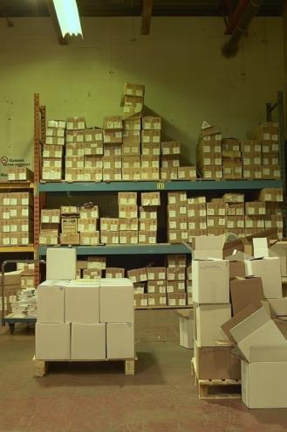
Basic Place Decisions
Distribution channels (trucks, pipes, air, water, etc.)
Market coverage (exclusive, selective, inclusive)
Inventory management
Warehousing
Transportation and logistics

Slide 21
Place: Customer Application
Products should arrive on-time in order to meet customer needs
Inventory shortage may drive customers away
A store’s location may impact buying decisions
Some customers are prone to specific product outlets, such as the Internet

Slide 23
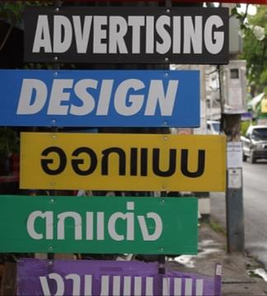
Promotion
Includes decisions about the following:
advertising
personal selling
sales promotions
publicity and public relations

Slide 24
Promotion
Relates to the timing of promotional campaigns
Refers to the type of message communicated to customers
Requires selecting media outlets
Creates activities and strategies to increase sales

Slide 25
Basic Promotion Decisions
Selecting advertising media
Creating personal sales force tactics
Designing sales promotions and special offers
Maintaining effective media and public relations
Establishing a marketing communication budget

Slide 26
Promotion: Customer Application
Brand awareness is the first step toward product sales
Public relations and advertising have a direct impact on customer loyalty
Promotion stimulates a need and desire to buy
Special offers or campaigns often yield higher sales results

Slide 27
Resources
Merrihew, B. C. (2006, January 23). The Fifth "P" of Automotive Marketing. Retrieved October 7, 2008, from iMedia Connection: http://www.imediaconnection.com/content/7866.asp
The Marketing Mix. (1999-2007). Retrieved October 7, 2008, from QuickMBA.Com: http://www.quickmba.com/marketing/mix/
The Marketing Mix. (2002-2007). Retrieved October 7, 2008, from NetMBA: http://www.netmba.com/marketing/mix/

Slide 28
Acknowledgements
Executive Producer
Gordon W. Davis, Ph.D.
Production Coordinator
Amy Hogan
Liz Weber
Brand Manager
Megan O’Quinn
Graphic Designer
Daniel Johnson
Technical Writer
Jessica Odom
V.P. of Brand Management
Clayton Franklin
© MMXIV
CEV Multimedia, Ltd.

