Slide 2
Objectives
To examine the economic importance of supply and demand.
To identify how supply and demand are inversely related.
To determine how the laws of supply and demand affect price and revenue.
To relate the laws of supply and demand to everyday life by identifying common uses.

Slide 3
Main Menu
Supply
Demand

Slide 4
Supply

Slide 5
Supply & Demand
Are inversely related
Directly affect prices
the higher in demand, the less supply is available and the higher the prices
the lower in demand, the more supply is available and the lower the prices
Explains trends in the economy such as inflation

Slide 6
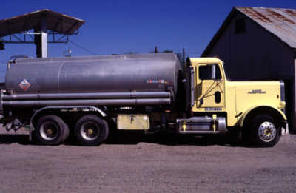
Supply
Is the amount of a good producers are able and willing to sell at various prices during a certain period
the relationship between price and quantity demanded
Assumes producers try to maximize their profits
Regards all things constant

Slide 7
Profit
Equals total revenue minus total costs
revenue is the amount of total sales for a given time period
total costs are all expenses paid by the company
Motivates the behavior of suppliers

Slide 8
The Law of Supply
States the quantity supplied is directly related to its price
lower price means smaller quantity supplied
higher price means larger quantity supplied

Slide 9
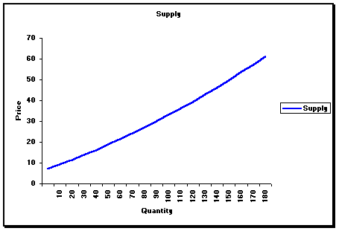
The Supply Curve
Demonstrates the law of supply
as the quantity rises, so does the price
Assumes the prices of all other goods remains unchanged
Is upward sloping since the relationship between price and quantity is directly related
www.peoi.org

Slide 10
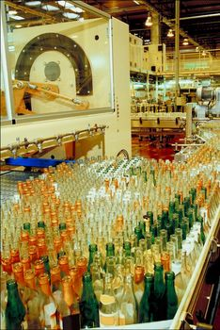
Shifts in the Supply Curve
Relate to the supplier’s change in price for a given amount of output
more product supplied leads to an outward shift of the supply curve, or an increase in supply
less product provided leads to an inward shift of the supply curve, or a decrease in supply

Slide 11
Willingness to Supply
Results from price increases of one good over another
if the price of hamburgers rise and hot dog prices remain the same, it is more profitable to put resources into hamburgers
Relies mainly on price indicators for both existing and potential suppliers
Results in a higher amount of product available for the consumer

Slide 12
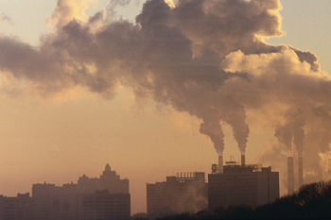
The Ability to Supply
Relies on the level of prices
higher prices increase the producer’s ability to create more products
Correlates with the marginal cost of production
Depends on the type of product provided
the supplies needed to manufacture a pair of tennis shoes are more readily available than natural resources such as oil

Slide 13
Elasticity of Supply
Measures the responsiveness of producers to a price change
higher prices encourage production, lower prices discourage production
Can be calculated by dividing the percentage change in quantity supplied by the percentage change in price

Slide 14
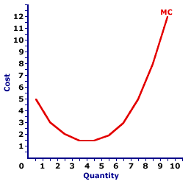
Marginal Cost
Is the cost of producing an additional unit of a good
change in total cost resulting from output changing by one unit
Can be shown through a U-shaped curve
as output quantities increase, marginal cost declines until it reaches a minimum value, then increases
Can be calculated by dividing the change in total cost by the change in output

Slide 15
Marginal Utility
Is the change in total utility resulting from consumption of a good changing by one unit
Demonstrates quantity and utility are inversely related through the law of diminishing marginal utility
the more of a good the consumer consumes during a period, the smaller the gain in total utility from consuming one additional unit
Utility: level of satisfaction derived from consumption of a good

Slide 16
Demand

Slide 17
Demand
Is the amount of product a consumer is willing and able to purchase at given prices
Assumes consumers try to maximize their satisfaction from consuming one unit of product
Is measured over a certain time period and holds all other things constant

Slide 18
The Law of Demand
States the quantity of a good demanded during the given time period is directly related to its price
the higher the price, the lower its demand
the lower the price, the higher its demand

Slide 19
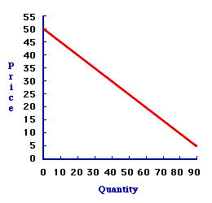
The Demand Curve
Demonstrates the law of demand
as the price rises, the good’s demand decreases
Assumes the prices of all other goods remains unchanged
Is downward sloping since the relationship between price and quantity is inversely related
www.amosweb.com

Slide 20
Shifts in the Demand Curve
An increase in quantity at a certain price is referred to as an increase in demand and is illustrated through moving the demand curve outward
A decrease in quantity at a certain price is referred to as a decrease in demand and is shown through moving the demand curve inward
Along the line, rather than moving the line, shows a change in quantity demanded rather than a change in demand

Slide 21
Equilibrium
Refers to the site which the supply curve intersects the demand curve
Is maximized with the combination of the highest profit and the lowest quantity supplied, netting the producer the highest amount of revenue
Increases and decreases directly with the increase or decrease of supply or demand

Slide 22
Wants vs. Needs
Wants are:
goods which are desired but not necessary
unlimited
sometimes unrealistic
Needs are:
goods which are necessary
sometimes not demanded by the consumer in their most basic forms
for example, you may need a new coat, but you want one with specific features

Slide 23
Consumer Willingness
Depends heavily on prices and personal financial habits
the higher the price, the less likely the good is to fall into a consumer’s budget or price range
Is affected by the ability to shop around and find better value
Varies from customer to customer, but generally causes equal products priced lower than others to be in greater demand
for example, if Store A sells a video game for $85, but Store B sells it for $100, Store A would experience a higher demand and sell out faster

Slide 24
Consumer Ability
Also relies heavily on both prices and personal financial habits
Takes into consideration whether the customer can afford the good
Accounts for high demand during sale and clearance times
Varies from customer to customer, but overall shows the higher the price, the less in demand it is

Slide 25
Elasticity of Demand
Measures the responsiveness of consumers to changes in price
higher prices discourage consumption, lower prices encourage consumption
Is calculated by dividing the percentage change in quantity demanded by the percentage change in price

Slide 26
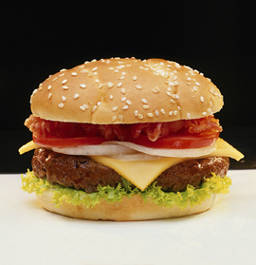
Complementary Goods
Are goods which correspond with each other
hamburger patties and buns
Experience simultaneous increases and decreases in demand
if the demand for hamburger patties increases, so will the demand for buns
Which are perfect are sold together because they must be consumed together
the left and right shoe

Slide 27
Substitutes
Are goods which can be used in place of one another
Coke® and Pepsi® can be substituted for one another
Rise in importance when the price of one of the goods increase or decrease
if Coke® raises its price and Pepsi® does not, more Pepsi® will be bought
Do not play as large a role when all prices change
if Coke® and Pepsi® raise prices, there will not be a large change in the amount of Coke® vs. Pepsi® purchased

Slide 28
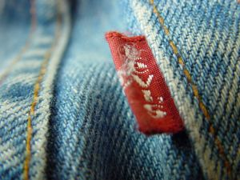
Brand Loyalty
Is the practice of remaining with one brand of product despite changes in price
Offsets the substitution effect because loyal customers will not buy other brands even if they are cheaper
Varies from customer to customer, but is usually developed when one product or company provides years of satisfaction, allowing consumers to grow comfortable and familiar with the company or product

Slide 29
The Income Effect
States money income is used to purchase goods, and if prices fall then it raises real income
Accompanies the idea lower prices increase the quantity demanded
example: If your money income is $40 a week and you spend the entire amount on hamburgers which cost $5, you can buy eight. If the price of hamburgers drops to $4, your real income has increased because now you can buy ten hamburgers.
Money Income: amount of money received during a specified period
Real Income: income measured in terms of how many goods can be purchased

Slide 30
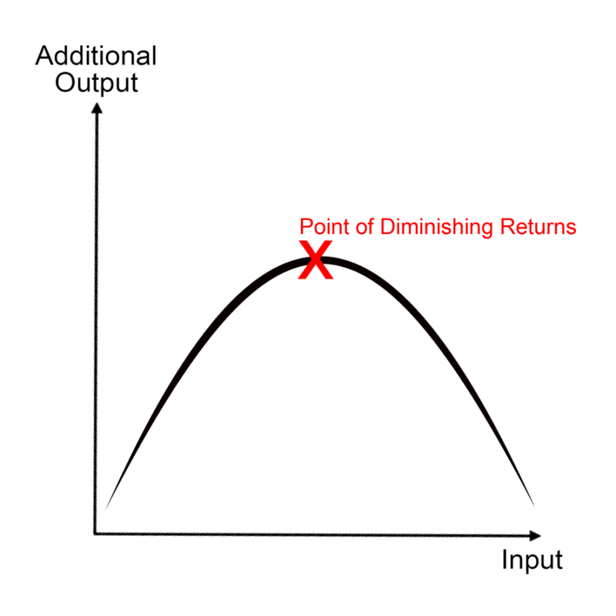
Law of Diminishing Returns
States when increasing amount of one factor of production increases, an increase in productivity will only occur to a certain point
related to marginal cost
Is commonly applied to production and manufacturers
Can also be applied to consumers

Slide 31
Example
Number of Cupcakes Eaten | Additional Satisfaction Gained
0 | 0
1 | 10
2 | 8
3 | 5
4 | 1
5 | -4
6 | -10
At first, a cupcake is “ten points” satisfying, but each additional cupcake is worth less satisfaction until eventually, additional cupcakes are detrimental to satisfaction (making you sick).

Slide 32
Producers
Have a good which can be further processed to create a more valuable final product
Are the beginning step in the manufacturing process
Compete with each other to provide the best starting material for a product

Slide 33
Raw Goods Producers
Also referred to as raw materials producers
Possess a product which has not been processed at all
Sell their product to manufacturers

Slide 34
Manufacturers
Purchase raw or partially processed goods to further modify into a final product
Are a good indicator of economic health
Employ a significant percentage of the American workforce

Slide 35
Builders
Are involved in the construction industry
Have changing job demands based upon:
the economy
housing market
business growth

Slide 36
The Trade Industry
Is comprised of companies in the trade field
the trade field encompasses jobs which are held by individuals who many times do not possess an advanced degree
Relies the most on the health of the economy
for example, in a bad economy, automobile workers may be laid off due to the lack of vehicle sales
Becomes more advanced as a country industrializes

Slide 37
Fortune 500 Assignment
Conduct research to determine currently five of the most financially successful businesses in the United States.
You may choose any company from 1 to 20 on the list
You must explain through a PowerPoint the goods and services offered by the business and why there is such a high demand from consumers.
For each company you must have the following slides
Title of Business w/Logo
General company information
Key Financials for the last fiscal year
Goods and/or services offered by the business
Slide detailing why there is such a high demand from consumers for their goods and services
http://beta.fortune.com/fortune500/list/

Slide 38
Resources
(2002-2007). Retrieved October 28, 2008, from NetMBA Business Knowledge Center: www.netmba.com
(2008). Retrieved October 28, 2008, from Drexel University: www.drexel.edu
WebFinance, Inc. (2010). Raw Materials Definition. Retrieved August 17, 2010, from http://www.investorwords.com/4048/raw_materials.html
United States Department of Commerce. (2010). Manufacturing. Retrieved August 18, 2010, from http://www.manufacturing.gov/index.asp
United States Census Bureau. (2010). Economic Indicators. Retrieved August 18, 2010, from http://www.census.gov/cgi-bin/briefroom/BriefRm
Trade & Industry Development Magazine . (2003). Trade & Industry Development. Retrieved August 18, 2010, from http://www.tradeandindustrydev.com/default.aspx

Slide 39
Acknowledgements
Production Coordinator:
Brandon O’Quinn
Technical Writer:
Jessica Odom
Project Coordinator:
Meghan Blanek
Production Manager:
Dusty Moore
Graphic Designer:
Ann Adams
Executive Producers:
Gordon Davis, Ph.D.,
Jeff Lansdell
© MMXIII
CEV Multimedia, Ltd.

