Slide 1
Spring break trip 2017
Tamia, Damani, Marko, Jason, Jalen

Slide 2
Spring break trip
Come out and have fun with us
March 19-25,2017

Slide 3
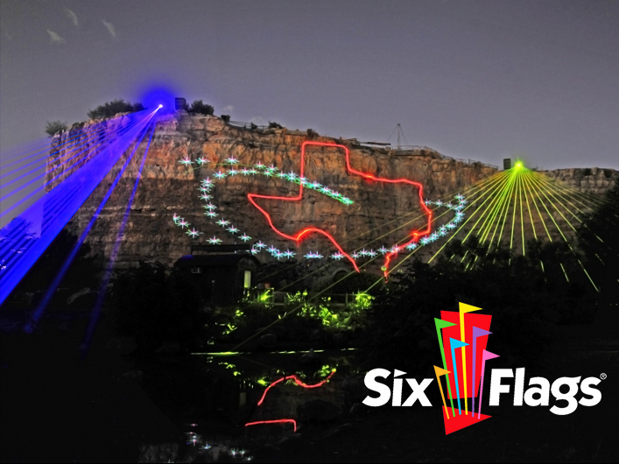
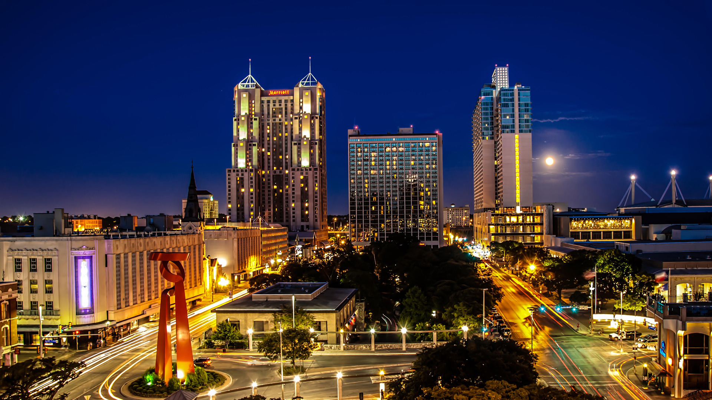
SAN Antonio

Slide 4
Public Relations
Who: Tamia Thibeaux
What: Public relations
Where: San Antonio
Why: create a positive image for the trip and to cultivate media relations with reporters who covers a specific industry
When: March 19-25,2017
How: Create an image for the trip to make sure it persuades them to want to go.

Slide 5
Personal Selling
Who: Damani Bennett
What: Personal Selling
Where: San Antonio
Why: generate direct contact with potential and existing customers
When: March 19-25, 2017
How: convince the school administration to improve the trip and help pay for the trip.

Slide 6
Advertising
Who: Jason
What: Advertising
Where: San Antonio
Why: promote the idea of the trip to variety services
When: March 19-25,2017
How: advertise the trip, promote the trip, and to get the idea out to the audience by telling the school announcements and oiler vision.

Slide 7
Direct Marketing
Who: Jalen
What: directing marketing
Where: San Antonio
why: target a group of potential students
When: March 19-25, 2017
How: direct market towards Pearland high school students and to direct mail and electronic mail about the trip.

Slide 8
Sales Promotion
Who: Marko
What: sales promotion
Where: San Antonio
Why: inform potential students about the trip and create a positive image.
When: March 19-25, 2017
How: create a positive image for the idea and to inform

