Slide 1
Recruiting, Resumes & Hiring
Your employees are the lifeblood of your organization. They’re the ones answering the phones, interacting with customers, and helping you develop and grow your business. Choose your employees wisely, and you’ll have an easier time becoming an industry leader. Choose your employees carelessly, and your business is almost destined to fail.

Slide 2
Recruiting
Recruiting is the process of finding and hiring the best candidates for any given open position—never stops. A key part of business management is being able to find top talent whenever and wherever it’s needed. Given this, it’s clear that recruiting is a vital skill for you and your organization to master. Richard Fairbank, CEO at Capital One, says, “At most companies, people spend 2 percent of their time recruiting and 75 percent managing their recruiting mistakes.” The goal, then, is to make work life easier, both for you and for those you recruit to work for your company.
Recruiting is serious business. According to recent research by Pricewaterhouse Coopers, 60 percent of CEOs don’t believe they have the qualified personnel they need to be successful, and 25 percent of CEOs say this lack of key talent prevents them from taking advantage of business opportunities that come along. Clearly, finding the right people is not a trivial matter.

Slide 3
Preparing for recruiting
Where are your needs? Before you’re ready to recruit for positions, you have to understand what your staffing needs are. Do you need three programmers, a copywriter, and three salespeople? Or will two programmers and two salespeople do the trick? Can you promote from within? For starters, it’s important to do a formal or informal needs assessment—and this will be an ongoing task—in order to learn about the number of employees and the skill sets you desire. Be sure to consult with colleagues as well. Keep the lines of communication open.
Depending on the size of your organization, there may be one or many individuals involved in sizing up your staffing needs and then working to fill vacancies. But whatever the composition of the recruiting team, there are several tasks associated with recruitment:

Slide 4
Preparing for recruiting
Create a job description - What is the name of the position you’re hiring for? What are the main tasks that the employee will be performing? What is the scope of the role?
Create a person specification - This is a profile of the ideal candidate. What special skills should a qualified candidate have? What personality traits would be most useful in this role? You should also think about the minimum level of competency for the role, since (as we’ll discuss below) your ideal candidate might not walk through the door.
Agree upon pay and perks - What will the salary range for the position be? What benefits will the person receive? Will he or she be able to telecommute (work from home) all or part of the time?
Once you’ve worked up a job description and understand the type of candidate and skills you’re looking for, in addition to the pay range and perks of the position, it’s time to start looking for desirable candidates.

Slide 5
Legal issues in recruiting
There are state and federal laws in place to prevent discrimination in the hiring process. Perhaps it goes without saying, but employers are forbidden by law from discriminating against someone in the hiring process because of age, gender, race, handicap, or sexual orientation. This prohibition extends from job advertisements all the way through to recruitment and pay. There are numerous federal and state laws in place, but they all boil down to one simple principle: everyone who could potentially do the job should be offered a chance to do so. According to the U.S. Equal Employment Opportunity Commission, various federal laws prohibit discrimination in hiring, employment, and firing:

Slide 6
Legal issues in recruiting
Title VII of the Civil Rights Act of 1964 (Title VII) prohibits employment discrimination based on race, color, religion, sex, or national origin
The Equal Pay Act of 1963 (EPA) protects men and women who perform substantially equal work in the same establishment from sex-based wage discrimination
The Age Discrimination in Employment Act of 1967 (ADEA) protects individuals who are 40 years of age or older
Title I and Title V of the Americans with Disabilities Act of 1990, as amended (ADA), prohibit employment discrimination against qualified individuals with disabilities both in the private sector and in state and local governments
Sections 501 and 505 of the Rehabilitation Act of 1973 prohibit discrimination against qualified individuals with disabilities who work in the federal government
Title II of the Genetic Information Nondiscrimination Act of 2008 (GINA) prohibits employment discrimination based on genetic information about an applicant, employee, or former employee
The Civil Rights Act of 1991 provides, among other things, monetary damages in cases of intentional employment discrimination

Slide 7
Don’t look for Purple Squirrels
Some recruiters use the term purple squirrel to describe the ideal job candidate. Writing for Harvard Business Review, Lance Haun purple squirrels this way: “These candidates are near-impossible to find in an ultra-competitive industry and possess the perfect mix of skills, education and experience. A good purple squirrel will work for peanuts (also known as the pay and benefits you’re willing to offer) and just happens to live in the same town as your company.”
The reality, however, is that purple squirrels are “the rarest of candidates, almost mythical in nature.” In other words, you’d be better served by looking for promising candidates who can be trained to do the job. This is important if you need to bring on new staff and don’t have the luxury of waiting many months for the ideal candidate to walk through the door.
Focus on finding “diamonds in the rough” that you can train and mentor. Look beyond the present and try to envision how the person could grow into the ideal employee in the future. In other words: Are they teachable? Are they a quick study? Are they a person of integrity? Are they positive?
Once you hire and train competent people, your job is to keep them and therefore reduce the number of people you’ll need to hire in the first place.

Slide 8
Consider your sourcing plan
Now that you’ve thought through your staffing needs, how will you find the candidates you need to fill your open positions? This is your sourcing plan.
Before you answer the question of how you’ll find quality candidates, you need to answer the question of who will be doing the recruiting. Will it be someone within your company (often a human resources specialist), or will it be an outside staffing agency? Staffing agencies can provide objective input to improve your hiring process. Specifically, they may be able to help you clarify the roles you should fill—and the type of people you want to fill them. On the other hand, they’re an added expense.
But regardless of who does the recruiting, the process follows several logical steps. Next comes the process of finding qualified candidates. Where do you look for them? (Remember that at this stage you’re just trying to fill your staffing pipeline with possible matches for your open positions. The next phase of the process, covered in the next section, will involve working through the pipeline to find the best candidates.)
There are more ways than ever to get the word out that your company is hiring. In the past it was common to take out ads in local newspapers or magazines, but today most candidate sourcing is done online. Sites like LinkedIn have become popular places to advertise open positions due to the massive number of skilled professionals who frequent the site to network as they seek to advance their careers. Craigslist is also a low-cost way to advertise open positions.
But there are offline ways to find talent as well. Career fairs, where your company rents out space to tell your company story and meet face-to-face with interested applicants, are always popular. Local colleges and universities can also be sources of talent, especially for entry-level positions. And don’t forget about employee referrals.

Slide 9
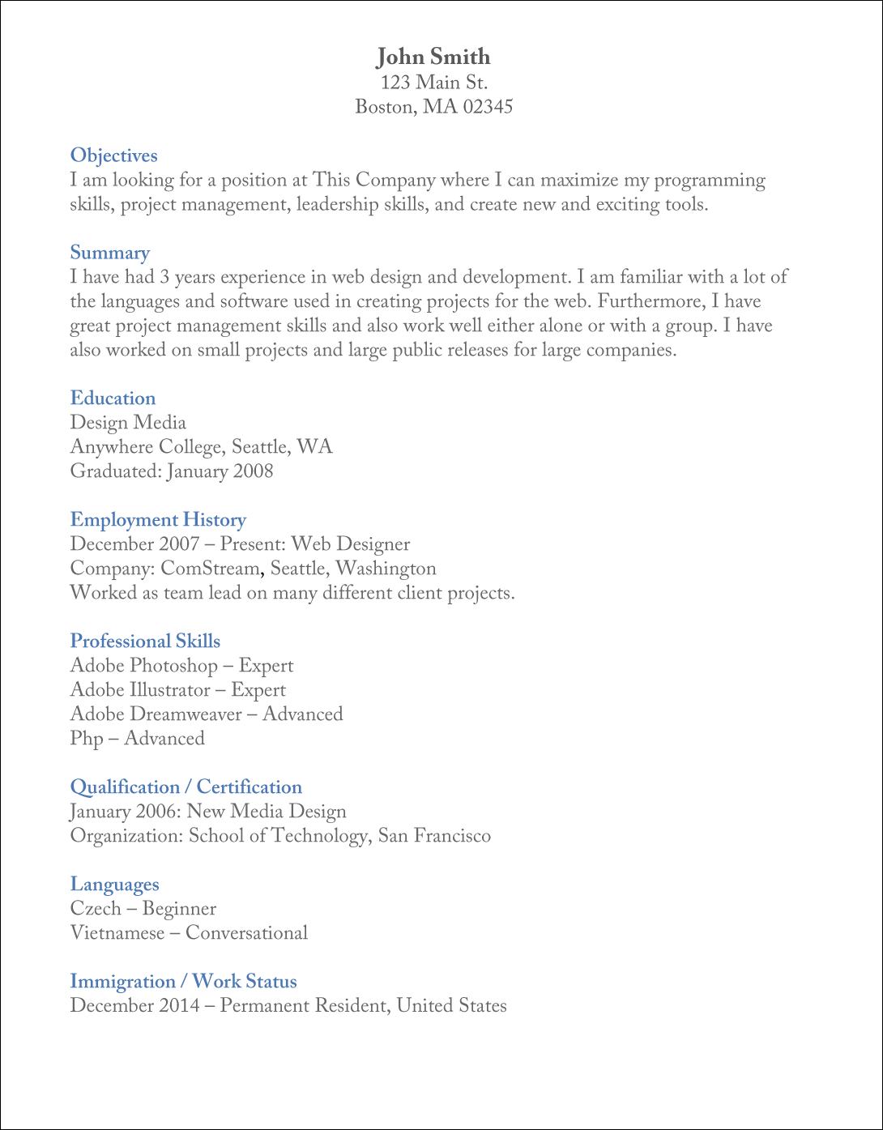

Slide 10
Screening and interviewing applicants
The traditional way to begin screening job applicants is by sorting through resumes (or CVs) received in response to your job posting. The resume is a document, usually a few pages in length, that outlines the applicant’s contact information, work history, and educational background. It may also contain the names of references as well as a list of the applicant’s skills.
A resume is a good way to determine whether the job seeker has the minimal requirements necessary for the job. For example, the job might require a college degree or expertise in a particular area. Sorting through resumes can help you develop a list of potential candidates.
Still, a resume can only take you so far. Once you determine the subset of applicants that fit the minimal job requirements, the next step is to speak to the applicants.

Slide 11
Screening and interviewing applicants
At this stage in the screening process, you may have too many applicants to realistically interview face-to-face, so many companies and managers rely on a phone screen to further pare down the list. A phone screen is essentially a brief phone interview where you ask each candidate a series of questions related to the position in order to assess whether they’d be a good fit—including a good fit with your company’s culture. The phone screen is useful because it will allow you to probe more deeply into the candidate’s work history and skills.
Sometimes this phone screen is preceded by asking the candidates to answer a series of “homework” questions. These questions are intended to give the phone screener a bit more information on the candidates’ backgrounds, values, and overall personalities. These questions may even take the form of a personality test (such as Myers-Briggs). Often the screener will refer to the answers given and ask the candidate to elaborate. This is a good way to test the candidate’s ability to think on his or her feet.
It’s vitally important at this stage to screen out candidates who may look good on paper (on a resume) but who might have exaggerated their skills or accomplishments. Conversely, other minimally qualified candidates might not present themselves as well on paper, but they’ll excel in the phone screen. Therefore it’s important for phone screeners to ask questions that look beyond the candidates’ specific skills and experience to get a better sense of how they handle problems, work with people, and learn and leverage new skills. The results may be surprising.

Slide 12
The in-person interview
If a candidate impresses the company, he or she will often be called in for at least one—or depending on the job, more than one—in-person interview. Given the time required by managers to schedule and conduct interviews, relatively few individuals from the original pool of candidates will make it all the way to the in-person interviews. These are people the company strongly suspects would perform well should they be offered the job.
Perhaps surprisingly, the in-person interview is not just about the interview itself. It’s about getting the applicants into their possible future work environment to see how they handle themselves. In some important ways, the in-person interview begins the moment they walk through the front door, and an applicant’s behavior can tell you and your company a lot of important things. For example, do they smile and chat with your receptionist or office manager? Are they dressed appropriately? Do they look confident?
When conducting the in-person interview, it’s important that key people within your company are present and asking questions. At a small company, even the highest executives might sit in, especially if they are interested in finding people to help establish the company culture and direction. For larger companies, group managers might be the key people involved.

Slide 13
The in-person interview
Sarah Kessler, writing for Inc. magazine, has identified several categories of questions you could ask candidates during an in-person interview:
Fact-based or general questions: Getting basic information about the applicant.
Situational or hypothetical questions: What would you do if X happened?
Stress questions: Blunt questions—Why should we give you the job?
Behavioral questions: Asking about specific instances where the candidate was able to put a desired skill into practice.
Researchers have shown that behavioral questions tend to be the most useful, though there is room for asking others. Behavioral questions are important because they reveal a pattern of thinking, such as problem solving, that you’d expect the candidate to carry through into the job. Thus it’s important to ask open-ended questions (as opposed to yes/no questions) in order to let the candidate express his or her personality in answering them.

Slide 14
Making an offer
The next step after the in-person interviews is contacting potential candidate’s references. These are people—usually former managers and colleagues—who can discuss how the person performed at their job, their strengths and weaknesses, and so on. The references should be able to validate some of the assumptions and impressions that the hiring team made about the candidate.
Assuming the references are positive, the next step is making the preferred candidate a formal job offer. This offer usually takes the form of an offer letter that’s mailed or emailed to the qualified candidate. In the letter, you restate the job description and then offer the candidate a certain salary or hourly rate. The candidate can accept the offer, reject the offer, or make a counteroffer. Once everybody agrees on the terms, the candidate signs the offer letter and gets a start date.

Slide 15
Onboarding
When the candidate starts, how will you accustom him or her to their new role? This is the onboarding process, in which you orient and train new employees to be successful in their new roles. Usually the onboarding process involves filling out benefits paperwork and reviewing company policies and procedures. It might then move on to formal training in the systems the company uses. It’s vital to make sure the new employee gets “ramped up” quickly so he or she can start contributing to the company’s growth. During a new employee’s first days, they form an impression of the company—but this is also when seeds of dissatisfaction can be sown that might eventually lead to underperformance and the employee’s departure. Therefore it’s important for the onboarding process to be as interesting, engaging, and helpful to the new employee as possible.

Slide 16
Key Terms
In-person interview: A type of job interview in which the candidate meets with company officials, usually at the employer’s headquarters
Job description: A document detailing what a person who takes a certain job will be required to do
Needs assessment: An internal company process to determine its staffing needs
Offer letter: A formal letter offering an individual a job
Onboarding: The process of orienting and training a new employee
Person specification: The distillation by a company of the type of person and the skills required for performing a role successfully

Slide 17
Key Terms
Personality test: A formal or informal assessment of a candidate’s personality, used to determine his or her suitability for the role
Phone screen: A telephone interview with a job candidate designed to assess whether he or she is a desirable enough candidate to go forward with an in-person interview
Purple squirrel: The ideal candidate for an open position
Recruiting: The process of finding and hiring the best candidates for any given open position
Resume: A short document produced by job seekers to outline their skills, experience, and interests
Sourcing plan: A formal or informal plan by a company that identifies the ways in which a company will seek out qualified job candidates

