Slide 1
Management Accounting
Accounting plays a large role in management. It’s the way in which you as a manager can track the financial health of your business. On a larger scale, accounting is what helps your company determine whether it will turn a profit, remain profitable, and ultimately stay in business.

Slide 2
Revenue, expenses, and profit
All accounting begins with revenue, which is defined as the amount of money (or income) that a company gets from its customers. This is money coming into the business, what accountants sometimes call the company’s top line. Usually a company derives revenue from selling products or services to its customers. In some cases a business will get revenue from other means, such as from royalties or interest from its various investments. For example, an electronics company might generate $10 million in annual revenue, with $3 million of that revenue from licensing its intellectual property to build special switches for medical devices.
While revenue is money coming into the business, an expense is money going out of the business. Expenses include money spent on raw materials, machinery (like laptops), and especially employee salaries and benefits (such as health insurance). It might also include expenses related to entertaining clients and prospects, such as business meetings.
Expenses are subtracted from revenue to arrive at a company’s profit. This is what accountants refer to as the company’s bottom line.
Note that a company’s accounting needs to take local, state, and federal taxes into account. Gross profit is profit before taxes have been paid, while net profit (also known as net income) is profit after taxes have been paid.

Slide 3
Assets and liabilities
Every company has resources that either have value or can be used to produce something of value. These are known as the company’s assets. There are two types of assets: tangible assets and intangible assets. A tangible asset is something you can touch, like your company’s building or the products in inventory. An intangible asset is something you can’t touch but still provides your company business value, such as software that your company produces. Assets are typically recorded on the left side of an accounting ledger.
A company also has liabilities (or debts). A liability is an obligation of the company to pay someone else for products or services rendered in the past. Liabilities might include things like employee salaries, employee benefits, utilities, taxes, money owed to suppliers, and loans.
Owner’s equity (or owner’s capital) is what’s left to the business owner once the company has paid all its debts.

Slide 4
Assets and liabilities
Financial accounting ties the concepts of assets, liabilities, and owner’s capital together in a mathematical formula known as the accounting equation:
assets = liabilities + owner’s equity (capital)
This equation forms the basis of double-entry bookkeeping. As the name implies, you make an entry twice, on each “side” of your accounting books (ledger).
For example, if you buy a car for the business and it costs $18,000, you’d have an $18,000 debit in the vehicle account and an $18,000 credit in the accounts payable account. The point is to make sure the books are balanced.

Slide 5
What is an income statement, and how do managers use it?
The income statement is a summary of the money a company brought in (revenue) and what it paid out (expenses). The idea is to track cash flow, whether it is positive (the company is turning a profit and is “in the black”) or negative (the company is losing money and is “in the red”). In other words, the income statement is designed to measure a company’s financial performance over a certain period of time.
Income statements have two parts: operating and nonoperating sections. The operating items section contains revenue and expenses information related to the company’s operations. For example, if a company manufactures basketballs, the operating items include the supplies and manpower required to produce the basketballs.
The nonoperating items section is where the company reports income and expenses not directly related to the company’s normal operations. For example, if the basketball company sold some adjoining property to a Starbucks, that would constitute nonoperating income on the company’s income statement.

Slide 6
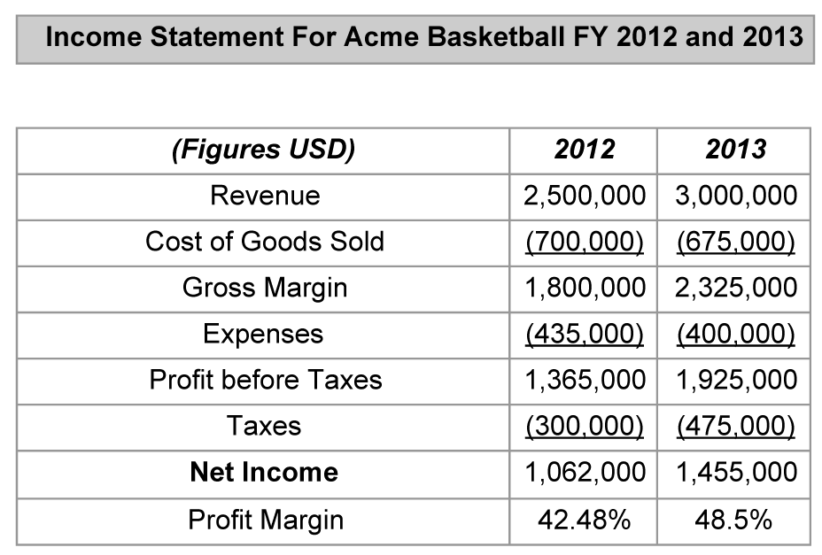
What is an income statement, and how do managers use it?

Slide 7
What is a balance sheet, and how do managers use it?
A balance sheet is the real-life representation of these equations. It’s a statement that highlights what a business owes (liabilities), what a business owns (assets), and how much shareholder equity (profits) exists at the time the balance sheet was generated. Unlike the income statement, which is generated for a given period of time, the company’s balance sheet is a snapshot of a company’s financial health at a particular point in time.
The balance sheet has two sides: assets and liabilities. Assets can include things like cash in the bank, the company’s property, equipment, and its product inventory. Liabilities include ongoing costs such as employee salaries and insurance benefits as well as its long-term debt. The difference between assets and liabilities is known by several different terms: shareholder equity, capital, net worth, or net assets.
The balance sheet is at the heart of double-entry bookkeeping. It is the statement that records assets and liabilities. One side of the ledger includes assets. The other side includes liabilities and shareholder equity. The idea is that the two sides of the ledger will be the same, or balance—hence the name balance sheet.

Slide 8
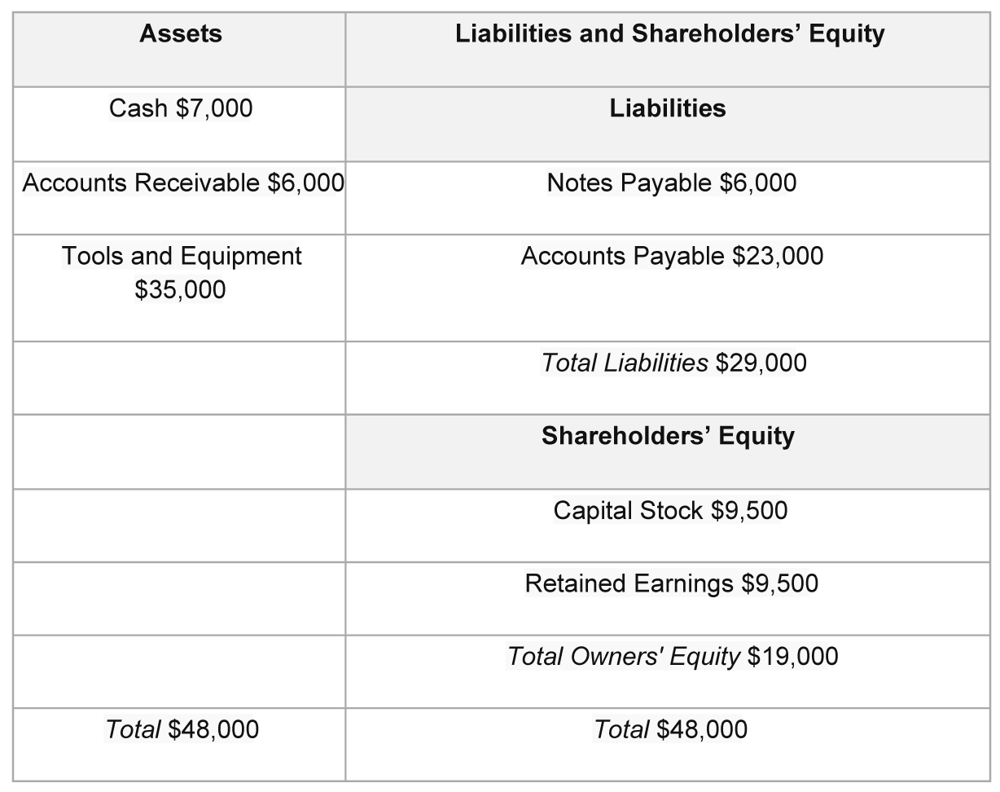
What is a balance sheet, and how do managers use it?

Slide 9
What is a balance sheet, and how do managers use it?
Balance sheet substantiation is the main method of making sure all of the company’s books are consistent with one another. This becomes especially important in large companies, but any company with more than one corporate division that keeps its own books should practice balance sheet substantiation. Companies typically institute processes, such as a formal sign-off by the accounting team, in order to ensure that their books are checked (for fraud or error) and balanced. This is done in order to keep compliant with federal regulations, but it’s also a useful way of being transparent by identifying how company money is being spent, which can lead to increased efficiencies and possibly help identify instances of fraud.

Slide 10
Key Terms
Assets: Resources that either have value or can be used to produce something of value.
Balance sheet: A statement that highlights what a business owes (liabilities), what a business owns (assets), and how much shareholder equity (profits) exists at the time the balance sheet was generated.
Cost of goods sold: What the company needed to spend (payments to suppliers, etc.) in order to generate its net sales.
Expenses: The money going out of the business. An expense could include money spent on raw materials, machinery (like laptops), and especially employee salaries and benefits (such as health insurance).
Gross margin: A company’s net sales minus the cost of goods sold.

Slide 11
Key Terms
Gross profit: Profit before taxes are paid.
Income statement: A summary of the money a company brought in (revenue), what it paid out (expenses), and the difference (profit).
Intangible asset: Something you can’t touch but still provides business value to your company.
Liability: An obligation of the company to pay someone else for products or services rendered in the past.
Net income (or net profit): A figure that indicates whether and how profitable the company has been during the reporting period (fiscal year).
Owner’s equity (or owner’s capital): What’s left to the business owner once the company has paid all its debts.

Slide 12
Key Terms
Profit: A business’s revenue minus expenses.
Profit margin: The company’s net income divided by net sales.
Revenue: The amount of money (or income) that a company gets from its customers.
Tangible asset: Something you can touch, like your company’s building or the products in inventory.

