Slide 1
Forms of Business Ownership
Businesses can take a variety of legal forms, each with its own advantages and disadvantages, so knowing more about each will serve you well.
we will discuss the most popular forms of business ownership: sole proprietorship, general partnership, limited partnership, corporation, S corporation, and limited liability company.

Slide 2
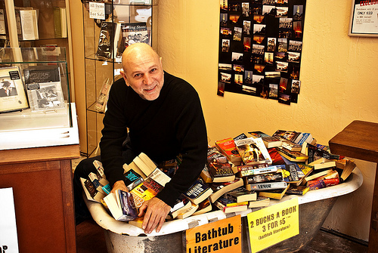
Sole Proprietorship

Slide 3
Sole Proprietorship
The sole proprietorship is the most common form of business ownership. As the name implies, a sole proprietorship is a business of one. For example, a freelance writer is considered a sole proprietor. According to the U.S. Census Bureau, there were 22.6 million nonfarm sole proprietorships in the United States in 2008, generating $265 billion in net income.
The business and the individual business owner are inseparable from a legal standpoint. All income and expenses from the business become part of the business owner’s annual tax filings. If the business is successful in a given tax year, the sole proprietor will owe taxes on the profits. If the business is unsuccessful in a given tax year, the sole proprietor will be able to deduct the loss on his or her tax return. On the other hand, the sole proprietor has the lowest tax rates of any of the types of business structures discussed in this chapter.

Slide 4
Advantages
It’s typically easy to set up—usually only a business license is required.
There is little if any paperwork required, and sole proprietors are in complete control over the business, without having to answer to other groups, such as a board of directors or shareholders.
Sole proprietors don’t have to share the profits from the business with anyone else.
It’s easy to dissolve (or end) the business.
it’s easy to prepare taxes for a sole proprietorship, since they’re just part of the individual’s tax return.

Slide 5
Disadvantages
The sole proprietor can’t get perks such as retirement accounts or health insurance funded by a company.
I the sole proprietor is successfully sued, they have unlimited legal exposure and could lose personal assets such their home.
The sole proprietor must pay all company debts from company funds and not personal assets—he or she alone is responsible for all company debts.
It may also be hard to raise money for the business because unlike other forms of business ownership discussed below, sole proprietors can’t raise money through activities like selling stock.

Slide 6
Partnerships

Slide 7
General Partnership
What if a business has more than one owner? In that case, the individuals would form a general partnership. The partnership is still not a distinct legal entity—it is the owners. Typically the partners will craft a legal document clarifying such matters as how the partners will share profits, resolve disputes, buy each other out, allow new partners to be admitted, and even dissolve the partnership. According to the U.S. Census Bureau, there were 3.1 million partnerships in the United States in 2008, generating $458 billion in net income.
While the partnership can incur debt in the name of the partnership, which gives it an advantage over a sole proprietorship, a partnership and a sole proprietorship do share most of the same disadvantages. In addition to those drawbacks, one partner can be held liable for another partner’s unethical or illegal behavior.
From a tax perspective, too, the partnership may not have to pay income tax in the name of the business entity, but each partner is still accountable for income and expenses on their personal income tax returns. While the partnership isn’t required to pay income taxes, it still must report any income, deduction and profits and losses every year through an annual information return. Partnerships are generally required to pay any employment taxes and excise taxes.

Slide 8
Limited Partnership
A limited partnership is almost identical to a general partnership, except that there is at least one limited partner.
The general partners run the day-to-day operations of the business and retain liability for profits and losses.
The limited partners, who don’t typically have a hands-on role in running the business, cannot lose any more than the amount they invested in the business, though they can profit from the success of the business.

Slide 9
Limited Liability Partnership
What if one partner doesn’t want to be exposed financially to, or be personally liable for, the possible malfeasance of another partner?
In that case the partners would form a limited liability partnership. In all other ways the limited liability partnership is the same as a general partnership.

Slide 10
Joint Venture
A joint venture is a general partnership that lasts only for a limited time, such as for the duration of a project.

Slide 11
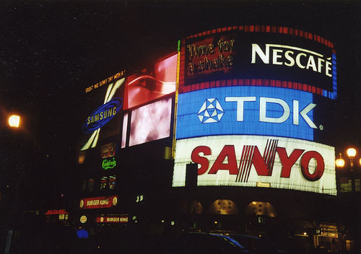
Corporations

Slide 12
Corporation
A corporation still allows individuals to band together, but it protects those individuals from personal liability if the business is sued. This is because the corporation is a separate legal entity, something that’s not the case with a partnership. Corporations can be designated either as profit or non-profit. According to the U.S. Census Bureau, there were 5.8 million corporations in the United States in 2008, , generating $984 billion in net income.
The corporation is essentially a legal fiction. In the eyes of the state where it’s incorporated, it’s considered an “artificial person” that comes into existence when an individual (the incorporator) files a form called the articles of incorporation. A shareholder is the name given to a person who owns the corporation. Most corporations have more than one, and sometimes hundreds or thousands, of shareholders. Corporations must have a board of directors, annual company meetings, and an annual report. They’re managed by these directors, who are elected by shareholders.
While it may perhaps sound confusing at first, the corporation, since it is a separate legal entity from the shareholder, runs the business on behalf of the shareholders, yet the shareholders have complete control.

Slide 13
Advantages
You can hire yourself as an employee and take advantage of the health and retirement plans mentioned above.
As an individual aren’t personally liable in a lawsuit brought against the corporation.
Your personal assets can’t be used to pay corporate debt.
Corporations can raise money through the sale of stock.
Corporations tend to have an easier time attracting quality employees because they can offer things like stock options and a wider array of insurance benefits.

Slide 14
Disadvantages
The individual does not have as much personal control over the direction of the business than if he or she were part of a partnership or even a sole proprietor.
Forming a corporation may result in higher taxes—corporations are issued a tax ID and must pay federal, state, and possibly even local taxes.
Corporations are taxed twice—first on profits and then on any dividends (profit sharing) paid to shareholders.

Slide 15
S Corporation
An S corporation is the same as a standard corporation, but with one difference: S corporations are taxed in the same way as a partnership. This means that, especially early on in the days of a corporation, a shareholder’s individual income can be used to offset any losses incurred by the corporation. In time, most S corporations will revert to a standard C corporation status when the corporation begins making regular profits. If the shareholders do make a profit, they must pay themselves only what the IRS terms “reasonable compensation”—paying too much could result in the IRS reclassifying all profits as wages and taxing them as such.

Slide 16
Nonprofit Corporation
A nonprofit corporation is a form of corporation that serves the public interest and therefore is not primarily concerned with turning a profit.

Slide 17
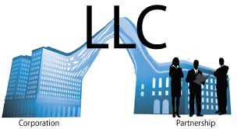
Limited Liability Company

Slide 18
Limited Liability Company
The most recent form of business organization is the limited liability company, or LLC for short. It’s available across the U.S. (49 of 50 states) and blends the best parts of a corporation and a partnership. One of more individuals form an LLC through a written agreement and are considered members of the LLC.
In terms of advantages, the LLC has the taxation pass-through of a partnership, while it has the limited liability of a corporation. In other words, partners are not typically liable for the debt of the LLC. There is also less paperwork and overall administrative overhead with an LLC as opposed to a corporation.
One disadvantage is that very often an LLC must be dissolved if one of the members leaves.

Slide 19
Limited Liability Company
According to the U.S. Small Business Administration (SBA), there are several steps to forming an LLC:
Choose a unique business name.
File the articles of organization. This includes your business name, address, and names of your members.
Create an operating agreement. While many states don’t require this, the SBA recommends this for LLCs with more than one member “because it structures your LLC’s finances and organization, and provides rules and regulations for smooth operation. The operating agreement usually includes percentage of interests, allocation of profits and losses, member’s rights and responsibilities and other provisions.”
Get the necessary licenses and permits.
If needed, hire employees.
Announce your business. Several states require this final step. These announcements typically appear in a local newspaper.

