Slide 2
Objectives
To compare different types of economic systems.
To identify characteristics of the private enterprise system.
To explore the four types of economies the United States has experienced.

Slide 3
Main Menu
Types of Economic Systems
Economics in the United States

Slide 4
Types of Economic Systems

Slide 5
Economic Systems
Are the way a society produces goods and services
Are the way a society provides and distributes goods and services to its citizens

Slide 6
Three Main Types of Economic Systems
Include:
command
market
traditional

Slide 7
Command/Communism Economic System
Maintains strong governmental control
Requires all productive resources to be owned and operated by the government
Forbids competition
Permits little to no freedom in selecting a career and workplace
Practices heavy taxation
Occurs in North Korea, Cuba and People’s Republic of China

Slide 8
Command/Communism Economic System
Advantages:
allows for large changes to quickly be made
chooses jobs for everyone, including government provided medical and social services
Disadvantages:
lacks in meeting consumer needs
prevents people from making their own economic decisions

Slide 9
Command/Socialism Economic System
Maintains medium governmental control
Practices governmental control in key industries, such as utilities and transportation
Allows private ownership in only non-vital industries

Slide 10
Command/Socialism Economic System
Allows competition in smaller, private sector
Permits the right to choose career and place of employment
Practices high taxation
Occurs in Sweden and France

Slide 11
Command/Socialism Economic System
Advantages:
provides medical care, education and social security benefits
allows businesses and individuals to keep some profits for their efforts
Disadvantages:
discourages small business ownership with heavy taxation and diminished income
controls important business sectors

Slide 12
Market/Capitalism Economic System
Derives from the principle of individual rights
Practices little governmental control
Encourages private ownership of business in all sectors
Supports competition in all areas

Slide 13
Market/Capitalism Economic System
Allows full freedom to choose career and workplace
Practices moderate taxation
Occurs in the United States, Hong Kong and Germany

Slide 14
Market/Capitalism Economic System
Advantages:
allows freedom to make economic decisions
practices low amount of governmental control
Disadvantages:
means sometimes great personal and financial risks must be taken with little or no guarantee of even a minimal return

Slide 15
Traditional Economies
Occur in less developed countries
Allow economic activities to be ruled by tradition
Rank religious and cultural values ahead of economics
Determine jobs according to ancestors’ jobs
Occur in Chad, Ecuador and Bangladesh

Slide 16
Traditional Economies
Advantages:
raises everyone to know his or her station in life
provides a stagnant and unchanging economic life because of resistance to change
Disadvantages:
stifles new ideas, technology and efficiency
differentiates the economic roles and status of men and women

Slide 17
Questions to Distinguish Economic Systems
Include:
what is the degree of governmental control
what freedoms are the people allowed
is competition allowed; if so, to what degree

Slide 18
Men in History
Adam Smith (1723-1791)
born in Scotland
father of modern economics; saw the market system acting as an “invisible hand,” which leads people to unintentionally promote society’s interests while pursuing their own

Slide 19
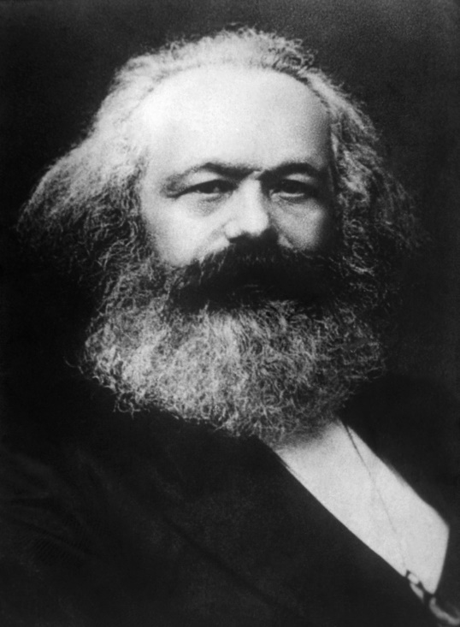
Men in History
Karl Marx (1818-1883)
born in Germany
intellectual father of modern day Marxist economics; predicted capitalism would be ultimately destroyed by its own inherent contradictions

Slide 20
Men in History
John Maynard Keynes (1883-1946)
born in England
ideas about the causes of unemployment revolutionized the macroeconomic theory and profoundly altered the government’s involvement in the economy

Slide 21
Economics in the United States

Slide 22
Private Enterprise System
Is synonymous with the Market/Capitalist economy
Emphasizes the private sector
Allows ownership of resources and businesses by individuals in society
Permits individuals, rather than government, to make economic decisions
Allows individuals to receive benefits and wages from employers

Slide 23
Private Enterprise System
Allows individuals have high levels of freedom to:
buy desired goods and services
produce and sell items
choose any career and workplace
“People must have the freedom to buy, the freedom to sell, the freedom to try and the freedom to fail.”
Adam Smith, Wealth of Nations

Slide 24
Private Enterprise System
Motivates businesses to succeed by:
promoting competition
meeting the wants and needs of customers
encouraging profits
Promotes entrepreneurship as an important aspect of an economy
entrepreneur organizes, manages and assumes the risks of a business or enterprise

Slide 25
Private Enterprise System
Allows entrepreneur to demonstrate the following characteristics:
communication skills
decision-making skills
knowledge of business operations
knowledge of financial resources
desire for self expression
persistence
ambition
initiative
patience
pioneering spirit
creative
risk-taking

Slide 26
Private Enterprise System
May also include negative aspects or disadvantages
production drops when sales are low
unemployment has the potential to occur
income and wealth may be unevenly distributed
consumers may be manipulated through advertising
not all resources are used efficiently

Slide 27
Basic Economies the U.S. has Experienced
Include:
agricultural economy
industrial economy
service economy
information economy

Slide 28
Agricultural Economy
Began at the dawn of civilization
Is based on farming
Was in place in early America
Was affected by inventions which increased agricultural production and efficiency, in turn increasing the overall standard of living

Slide 29
Agricultural Economy
Included inventions such as:
cotton gin in 1793
patent on Glidden barbed wire in 1874

Slide 30
Industrial Economy
Took over in America in the late 1700s and into the 1800s
Began due to inventions which led to industry growth
in 1793, Samuel Slater constructed the first successful textile mill in America

Slide 31
Industrial Economy
Caused people to move to cities and begin working in factories
between 1790 and 1987 agricultural employment declined from 90 percent to 2.9 percent
Included poor working environments

Slide 32
Service Economy
Took over in America in the early 1900s
Began because of the increase in the standard of living
as the standard of living increased, so did the demand for services, so people started selling their services

Slide 33
Information Economy
Took over in America in the late 1900s
Began as society increasingly needed easily accessible, accurate information
Is largely affected by the exponential rate at which technology develops
Includes the emergence of the Internet and World Wide Web
Has been impacted considerably by Bill Gates

Slide 34
Acknowledgements
Production Coordinators
Krista Scott
Amy Hogan
Brand Manager
Megan O’Quinn
Graphic Designer
Melody Rowell
V.P. of Brand Management
Clayton Franklin
Executive Producer
Gordon W. Davis, Ph.D.
© MMXVI
CEV Multimedia, Ltd.

