Slide 1
Types of Business Ownership

Slide 2
Objectives
To examine the steps to the process of becoming a business owner.
To differentiate the various types of business ownership.

Slide 3
Business Ownership
Is the individual or groups which own a business and its legal entities
Includes:
determining which type of business fits the needs of the owner
securing financing
naming the company
protecting business ideas
licenses and permits
location
Legal Entity: law which allows a group of people to conduct business as a single unit – for example: a group ownership

Slide 4
Ways to Becoming a Business Owner
Include:
starting a new business
purchasing a franchise
purchasing an existing business (non-franchise)
taking over family business

Slide 5
Types of Business Ownership
Includes:
sole proprietorship
partnership
corporation
franchise

Slide 6
Sole Proprietorship
Is owned and operated by one individual
Is the most common form of business ownership
Requires the owner to be able to provide the funds, resources and managerial responsibilities to start and run a business

Slide 7
Advantages
Include:
relatively simple with less taxes and government regulations
entitlement to all profits of the business
relatively easy to start
easy to maintain business confidentiality

Slide 8
Disadvantages
Include:
harder to raise money to expand the business since the company’s shares are not sold
unlimited liability
complete personal responsibility for all business debts and losses
if sued the proprietor can lose a portion of personal assets
higher start-up cost
owner may have limited skills

Slide 9
Partnership
Is a legal agreement between two or more people to be responsible for a business
Is the least common form of business organization
Can have two forms
general partnership
limited partnership

Slide 10
Partnership
General partnership
partners share equal liability in the profits and losses of the business
Limited partnership
partners have an unequal share and liability in the business; they are responsible only for the amount they invested

Slide 11
Advantages
Include:
easy start-up
combines the skills of two or more people
more money could be available to operate or expand the business
each partner has a voice in the business operation
taxed and monitored less heavily than a corporation

Slide 12
Disadvantages
Include:
disagreements about business decisions can arise between partners
actions of one partner are legally binding for the other partners
if one partner dies, the partnership is dissolved and must be reorganized as a new partnership which can consume time
partners must contend with the fact they are working under unlimited liability

Slide 13
Corporation
Is the most complicated form of business
Is a separate legal entity
Forms boards to act as
governing bodies; hires
directors and officers to
manage the business
affairs
Separate Legal Entity: a business which is granted a charter establishing its own rights, privileges and liabilities distinct from those of its members

Slide 14
Corporation
Ownerships of the corporation can be shares of stock, which are bought on the stock market by stockholders
Is subject to many governmental regulations

Slide 15
Advantages
Include:
easier to raise wealth and assets for company expansion than other forms of business
easier for people to enter or leave; can usually simply buy or sell company stocks
limited liability for each owner
responsible for amount of liability equal to amount of money invested in company
each department can easily be managed by a professional in the area

Slide 16
Disadvantages
Include:
is difficult to build
process of incorporation requires more time and money than other forms of organization
can be very complex, especially accounting and record keeping
has more analyzed governmental regulations
can increase taxes on corporate profits and on its shareholders

Slide 17
Franchise
Is the right or license to sell a company’s product or service at a designated location
Involves:
franchisor: a business which leases its trade name and operating system to another person
franchisee: person or persons who pay fees to a company to operate a business under the franchisor’s trade name

Slide 18
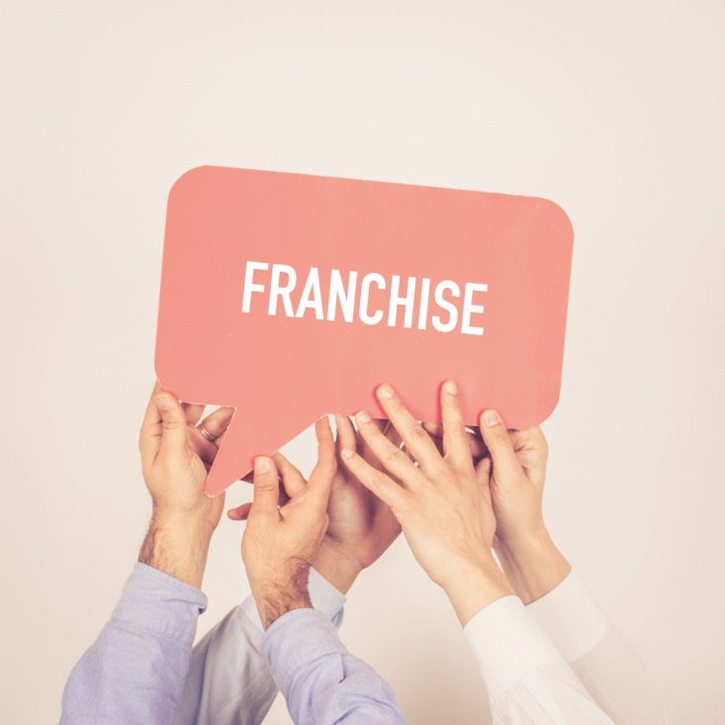
Advantages
Include:
assistance from parent company
parent company shares experiences and proven techniques
name recognition
McDonalds®
Sherwin Williams®
shared advertising expenses

Slide 19
Disadvantages
Include:
high purchase fees
percentage of sales or yearly fee paid to parent company
must follow parent company business structure

Slide 20
Choosing a Business Operation
Is the most important decision made in structuring a company
Has factors which will help influence the decision, such as:
legal restrictions
liabilities assumed
earnings distribution
capital needs
number of employees
Capital: wealth in the form of money or property, used in a business by a person, partnership or corporation

Slide 21
Choosing a Business Operation
Can be easier if these factors are also weighed with the advantages and disadvantages of each type of ownership

Slide 22
Forms of Business Ownership Assignment
Students will design a PowerPoint that illustrates the four most common types of business ownership covered in this lesson. The PowerPoint should give a concrete example of real life community businesses in Pearland and/or immediate surrounding areas for each category.
Sole Proprietorship
Partnership
Corporation
Franchise
For each slide you should have the following:
Title Slide w/name(s)
What form of ownership
The logo/name of the business
A company description justifying why the business falls into that ownership category
A picture of the business

Slide 23
Resources
(2009). Retrieved March 16, 2009, from U.S. Small Business Administration: http://sba.gov/
Glossary. (1995-2004). Retrieved March 16, 2009, from Pearson Education: http://wps.pearsoned.co.uk/wps/media/objects/1065/1090612/glossary.html
What Are Patents, Trademarks, Servicemarks, and Copyrights? (2004, May 12). Retrieved March 16, 2009, from United States Patent and Trademark Office: http://www.uspto.gov/web/offices/pac/doc/general/whatis.htm

Slide 24
Resources
Stephenson, J. (2010). Start a Service Business. Retrieved August 17, 2010, from http://www.entrepreneur.com/startingabusiness/businessideas/article80686.html
World Bank. (2009). Growth of the Service Sector. Retrieved August 17, 2010, from http://www.worldbank.org/depweb/beyond/beyondco/beg_09.pdf

Slide 25
Acknowledgements
Executive Producer
Gordon W. Davis, Ph.D.
Assistant Brand Manager
Jake Porsch
Amy Hogan
Graphic Designer
Melody Rowell
Brand Manager
Megan O’Quinn
V.P. of Brand Management
Clayton Franklin
CEV Multimedia, Ltd.
© MMXVI

