Slide 1
Advertising
Analyzing the Sales Process
Notes:
Title slide

Slide 2
WHAT IS ADVERTISNG?
Advertising is a paid-for
form of communication.
It is the non-personal promotion of a cause, idea, product or service by an identified sponsor attempting to inform, persuade or remind a particular target audience.
Notes:
Notes: Advertising was estimated at more than $300 billion in the United States^{[1]} and $500 billion worldwide^{[Wikipedia.com}

Slide 3
CONSUMERS AND THEIR NEEDS
A CONSUMER IS SOMEONE WHO USES PRODUCTS.
CONSUMERS CHOOSE TO BUY ITEMS THAT ARE NEEDS OR WANTS.
CONSUMER BEHAVIOR IS EVERYTHING THAT AFFECTS OR IS AFFECTED BY HUMAN CONSUMPTION.
Notes:
Have students give examples of wants and needs they have recently purchased.

Slide 4
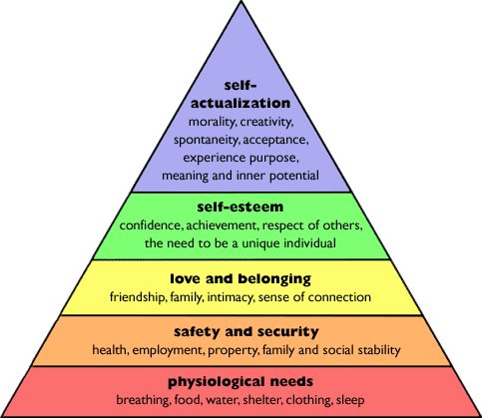
Maslow’s Hierarchy of Needs
UNT in partnership with TEA, Copyright © All rights reserved 2
Notes:
Go over each part of the pyramid and ask students to give example that you write on the board. Give students the blank picture of the pyramid. They can fill in the notes as you cover the material in class.

Slide 5
WANTS
Economic
Material goods and service
Basis of an economy
Clothing, housing, cars
Hair styling, medical care, airline tickets
Non-economic
Sunshine
Fresh air
Exercise
Friendship
Happiness

Slide 6
Needs and Wants
Needs and wants are unlimited.
Needs and wants are only limited by the minds of consumers.
Many purchases are related to additional purchases.
Businesses respond to needs and wants when they can make a profit.
Notes:
Give examples of add-on sales. When an individual purchases new shoes, they may also purchase a belt that matches the shoes and new socks. Purchasing a new house leads to purchasing appliances and furniture.

Slide 7
Product Features-
May be basic, physical or extended attributes of the product.
The most basic feature of a product is its intended use.
Consumers look for qualities of a product that differentiate competing brands.
Additional features add more value to a products and provide reason for price differences.
Notes:
Role play features and benefits with students

Slide 8
Product Benefits -
Benefits for the customer
Advantages or personal satisfaction one gets from the product use
Product benefits become selling points for the salesperson.
Notes:
Use slide to continue role-plays.

Slide 9
Maslow’s Hierarchy of Needs
Log in to www.phsbmf.weebly.com and download the PowerPoint (Advertising_and_Sales_Ex) detailing each part of the Maslow’s Hierarchy of Needs pyramid.
For each of the five sections find an ad that represents that section and give the reason why you believe that ad represents that section.

