Slide 1

Unit: Principles of Marketing
Lesson 1: Customer Relationships

Slide 2

What Is Marketing?
Developing, promoting, and distributing products to satisfy the wants and needs of a customer
2-Way street connecting product maker/seller with customer

Slide 3
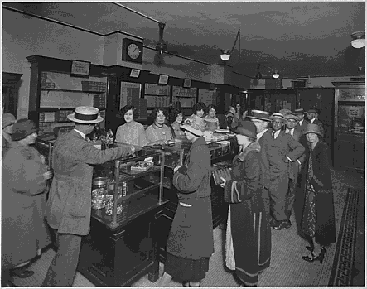
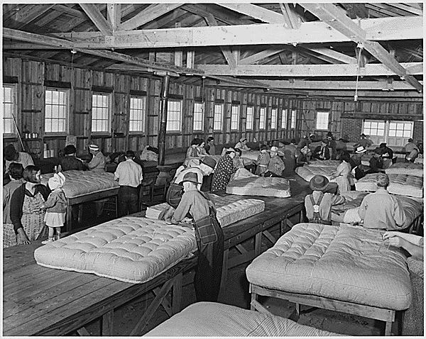
Evolution of Marketing
Over time, marketing has evolved to meet business needs.
Production Era - In the early 1900’s, businesses were mainly focused on producing a large amount of goods as quickly as possible. At the time, supply was below demand, and customers didn’t have a lot of choices. Most products were purchased as soon as they were made and distributed.
Selling Era - As production continued to increase, supply started to exceed demand for many products in the 1920s. This situation led to a heavy focus on selling. It included more advertising, larger sales forces, and sometimes high-pressure sales tactics. This focus continued into the 1930s and 1940s when customers had limited money to part with due to the Depression and World War II.
Marketing Era - The 1950s were a time of relative peace and prosperity. Factories that had churned out military supplies began making new items for civilians, and the products flooded the market in many categories. In order to compete, businesses adopted a new philosophy called the marketing concept.
Relationship Era - In the 21st century, the marketing concept evolved into a new era focusing on long-term customer relationships. Getting a new customer costs much, much more than keeping an existing one. When a current customer spends more of his or her money on your products, it is very cost-effective. And satisfied customers help to promote your business to others.
Notes:
Discuss how marketing has changed…
Production Era
In the early 1900’s, businesses were mainly focused on producing a large amount of goods as quickly as possible. At the time, supply was below demand, and customers didn’t have a lot of choices. Most products were purchased as soon as they were made and distributed.
-----
Selling Era
As production continued to increase, supply started to exceed demand for many products in the 1920s. This situation led to a heavy focus on selling. It included more advertising, larger sales forces, and sometimes high-pressure sales tactics. This focus continued into the 1930s and 1940s when customers had limited money to part with due to the Depression and World War II.
-----
Marketing Era
The 1950s were a time of relative peace and prosperity. Factories that had churned out military supplies began making new items for civilians, and the products flooded the market in many categories. In order to compete, businesses adopted a new philosophy called the marketing concept.
In the marketing concept, a business focuses all of its efforts on satisfying the needs and wants of its customers. The marketing concept gives businesses a way to view and evaluate all of their operations with the customers in mind.
-----
Relationship Era
In the 21st century, the marketing concept evolved into a new era focusing on long-term customer relationships. Getting a new customer costs much, much more than keeping an existing one. When a current customer spends more of his or her money on your products, it is very cost-effective. And satisfied customers help to promote your business to others.

Slide 4

Classification of Markets
Market- is a group of people who need products in a given category and who meet these three criteria:
They must want the product.
They must have means to purchase the product.
And they must be authorized to purchase the product.

Slide 5


Classification of Markets
Consumer (B2C)
Business-to-Business (B2B)
Will use the product
Will not use the product for profit
Will use product to make other products or to resell
Notes:
Before revealing, ask students if they can guess the difference between the two market types.

Slide 6
Customer Behavior
Understanding customer is critical for success
Consumer and business buying behaviors are different

Slide 7
Customer Behavior- Consumer
Influences of consumer buying decisions include:
Personal elements
Psychological elements
Social elements
Cultural elements
Notes:
Discussion: Ask students to list the things they consider when making a buying decision.

Slide 8
Customer Behavior- Business
Business buyers are:
Trained to negotiate
Specialists in a line of items
Experts about the products

Slide 9

Consumers and Branding
A brand represents the holistic sum of all information about a product or group of products. This symbolic construct typically consists of a name, identifying mark, logo, visual images or symbols, or mental concepts which distinguishes the product or service. A brand often carries connotations of a product's "promise", the product or service’s point of difference among its competitors which makes it special and unique. Marketers attempt through a brand to give a product a "personality" or an "image". Thus, they hope to "brand", or burn, the image into the consumer's mind; that is, associate the image with the product's quality. Because of this, a brand can form an important element of an advertising theme: it serves as a quick way to show and tell consumers what a supplier has offered to the market.
Well known products acquire brand recognition. A brand name comprises that part of a brand consisting of words or letters that humans can verbalize. A brand name that has acquired legal protection becomes a trademark.
Notes:
Discussion: Have students list ways they have been marketed to in the past.

Slide 10
Consumers and Branding
Branding has become part of pop culture. Numerous products have a brand identity: from common table salt to designer clothes. Non-commercially, branding can also apply to the marketing of entities which supply ideas or promises rather than goods and services -- such as political parties or religious organizations.
Consumers as a group may look on the brand as an important aspect of a product, and it can also add value to a product or service. It carries the reputation of a product or company. A branded laundry detergent may sell twice as much product as a store-brand detergent. Although the two products may resemble each other closely in almost every other respect, people have learned to regard the branded product as superior. In some cases they believe that because it costs more it offers better quality.
Notes:
Discussion: Have students list ways they have been marketed to in the past.

Slide 11
ATTENTION
Place phones in the holder on the cabinet please until we are done with PowerPoint.
Then you may retrieve them and use during work.
If its out during PowerPoint I will take it until the end of the period.
Notes:
Discussion: Have students list ways they have been marketed to in the past.

Slide 12

Unit: Principles of Marketing
Lesson 2: Market Segmentation and Marketing Mix

Slide 13

Marketing Strategy and Planning
Use resources to increase sales and gain competitive advantage
Identify target market
Develop marketing mix

Slide 14
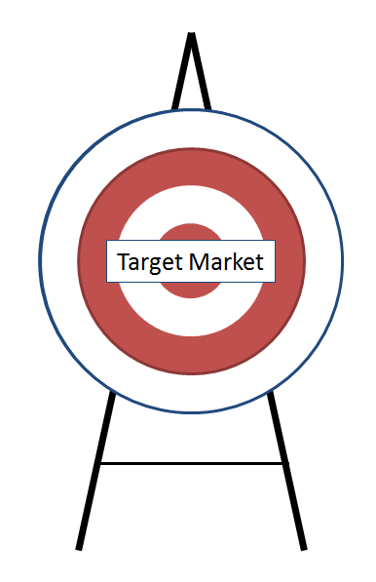





Target Market and Market Segmentation
Target market- group of people most likely to buy a product
Market segmentation- Dividing a groups of customers, or “segments”
Notes:
Target Market
Group of people likely to buy a product
They will have similar wants and needs
Market segmentation: segments are similar to one another and different from everyone else
Analysis of customers; not products

Slide 15
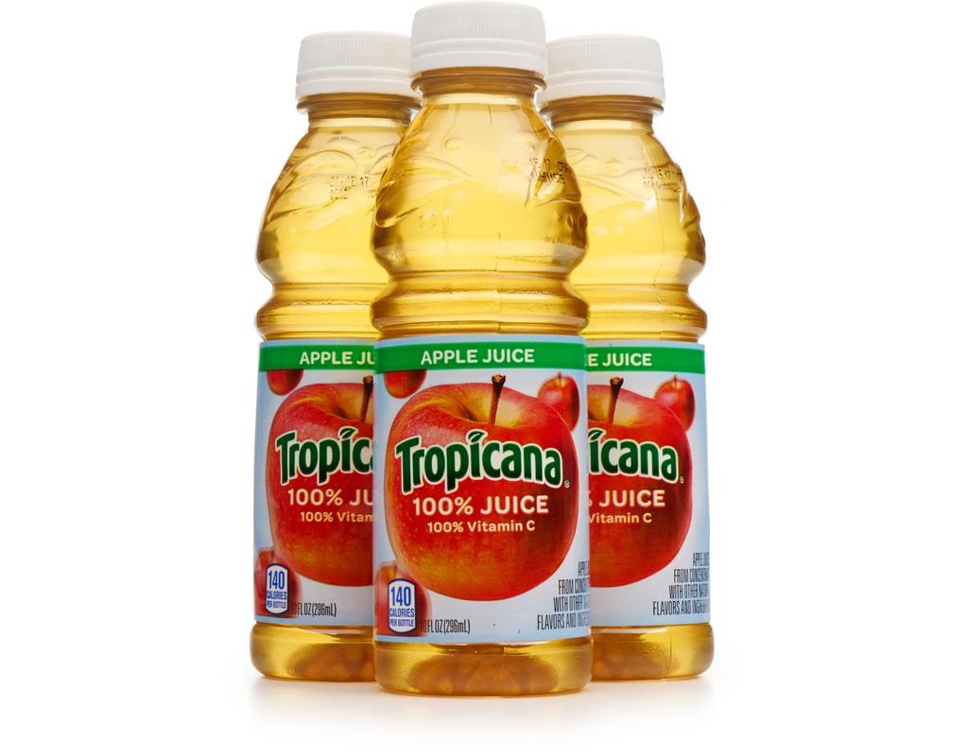
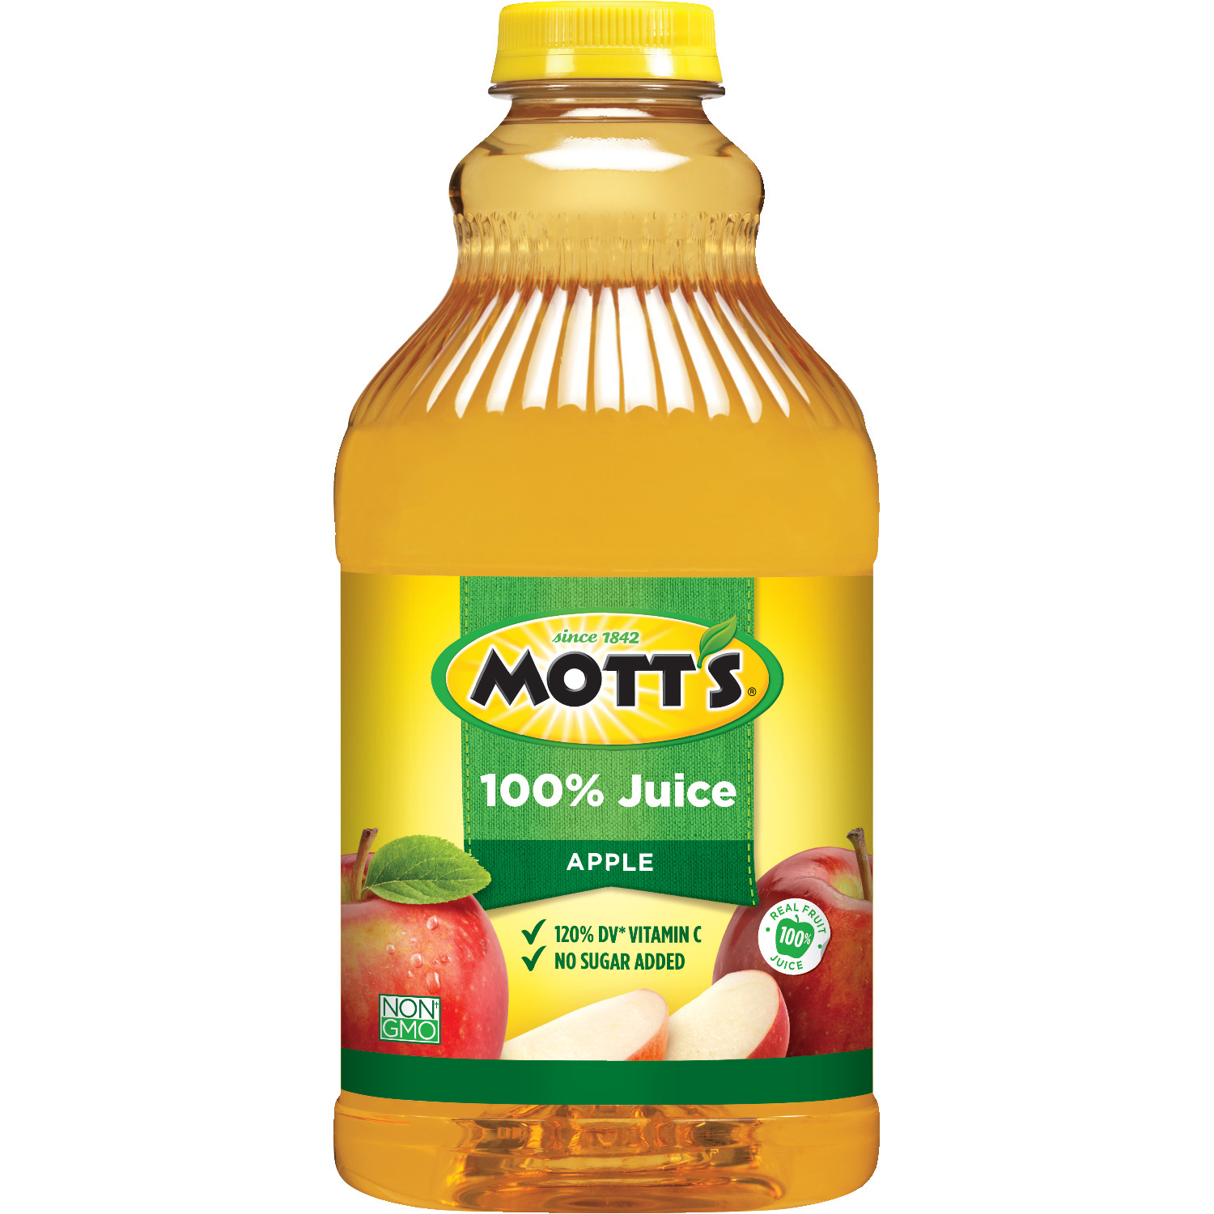
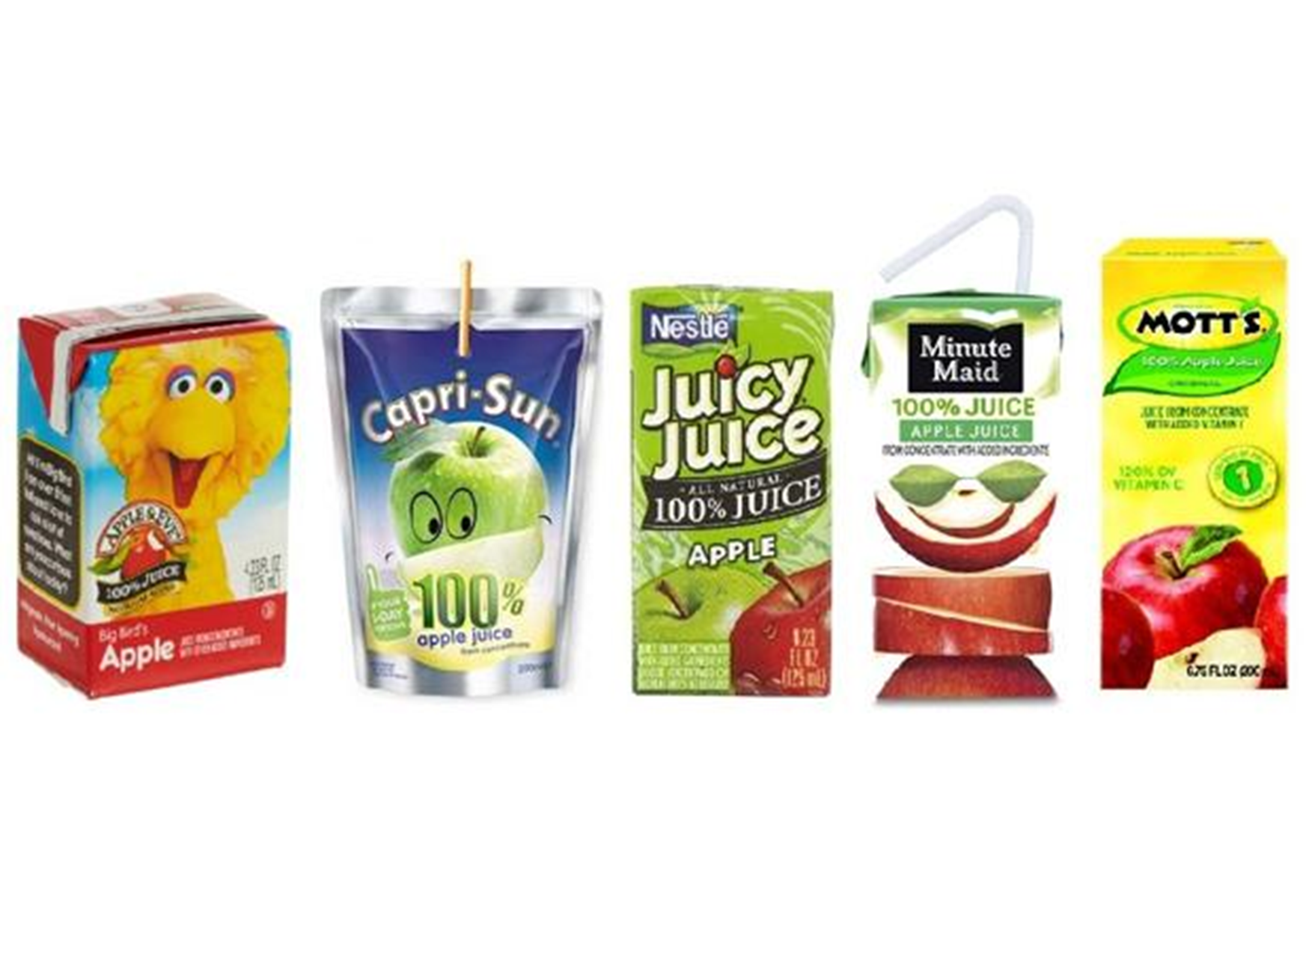
Target Marketing
Target marketing can be seen in the different ways apple juice may be packaged.
Notes:
Introduce the apple juice example (listed below). After, have students discuss or list other examples of target marketing they can think of. (Hint, product packaging yields a lot of good results)
An example of target marketing can be seen in the different ways apple juice may be packaged:
-----
Small, disposable boxes or bottles with individual servings are aimed at busy consumers who pack lunches.
-----
Medium-sized cartons or bottles would be more likely to be used in a home setting by consumers living with multiple family members.
-----
Very large containers of juice would be targeted toward buyers at institutions with cafeterias, such as schools and hospitals.

Slide 16

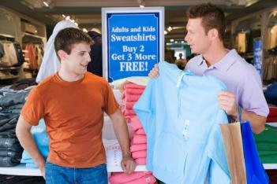
Consumer Market Segmentation
Four factors of consumer market segmentation:
Demographic: traits.
Geographic: information about places where people live.
Psychographic: attitudes, values, interests, lifestyles.
Behavioral: how people act in relation to products.
Notes:
Consumer Market Segmentation
Demographic: traits
Geographic: information about places where people live
Psychographic: attitudes, values, interests, lifestyles
Behavioral: how people act in relation to products

Slide 17
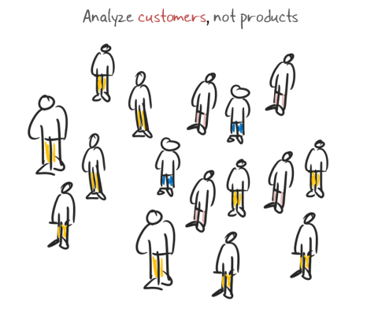
Business Market Segmentation
Three factors of consumer market segmentation:
Geographic: where customers are concentrated
Customer-based: characteristics of customers
Product-use-based: how customers use the product
Notes:
Business Market Segmentation
Geographic: where customers are concentrated
Customer-based: characteristics of customers
Product-use-based: how customers use the product

Slide 18

Marketing Mix
Product: fills customer’s wants or needs
Pricing: how much will be charged for goods or services
Place: distribution
Promotion: communication directed towards customer
Notes:
Marketing Mix
Product: fills customer’s wants or needs
Pricing: how much will be charged for goods or services
Place: distribution
Promotion: communication directed towards customer

